Slide 1
Synthetic Data Generation

Slide 2
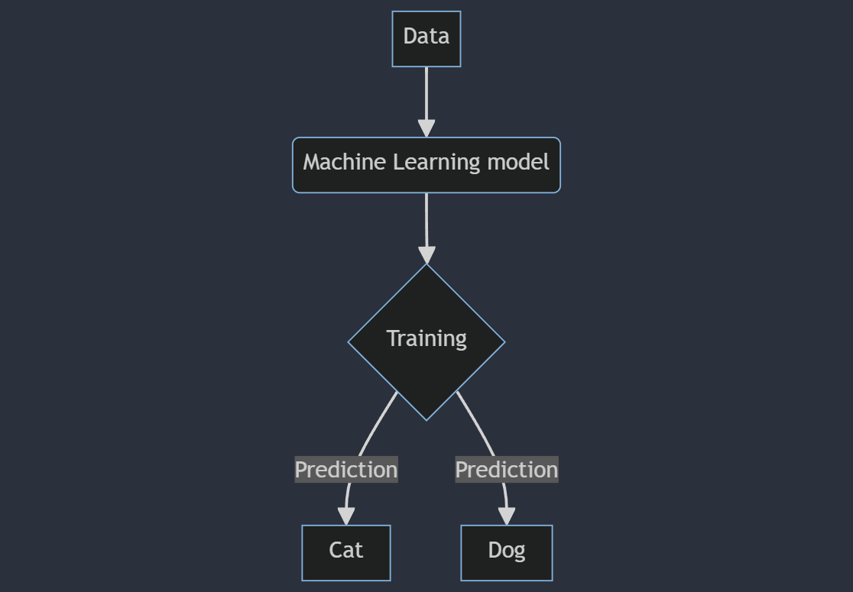
Why Synthetic Data?
Machine Learning (ML) models
More Data -> Better Performance (Generally)
Quality ≈ Quantity
High quality data is important
Data Scarcity
Privacy Concerns
Cost and Time
Synthetic Data
Notes:
ML models rely on input data to learn patterns and make generalized predictions. Generally, the more data the better.
Not all data is good data. Quality matters just as much as quantity.
High quality data is important, because poor quality data can lead inaccurate models that do not generalize well to unseen data.
The problem is that high quality data is difficult to obtain in most cases.
Artificial data that mimics the statistical properties of real data. SD can tackle these issues.

Slide 3
Methods
Classical Approaches
Replacing values or Adding noise
Statistical Models
Deep Learning Approaches
Variational Auto-Encoders
GANs (Generative Adversarial Networks)

Slide 4
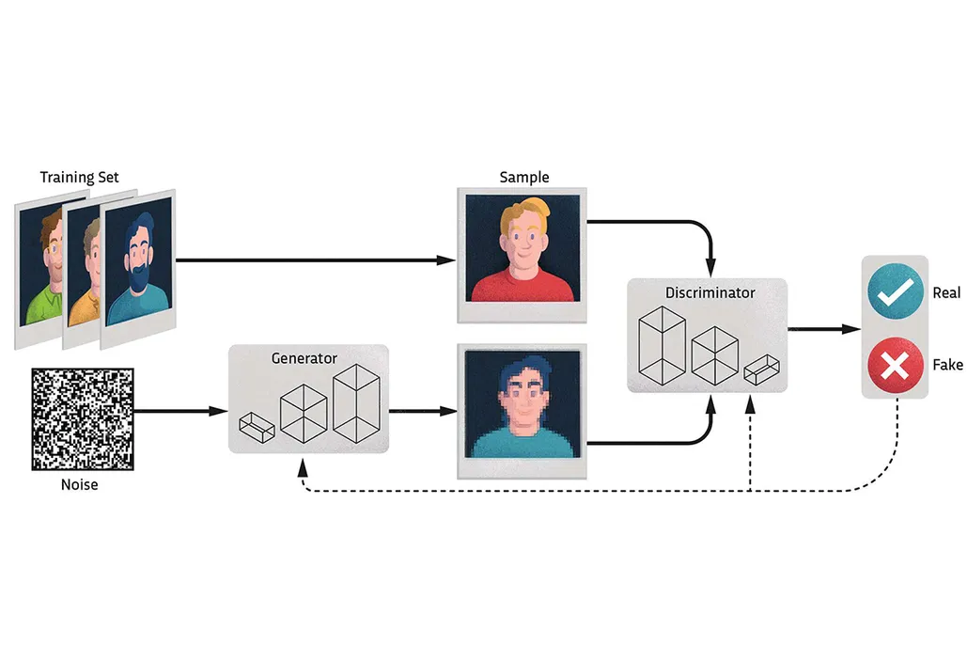
GANs
MiniMax Game: The Generator creates realistic fake samples, while the Discriminator tries to tell real samples from fake ones
Notes:
Over time, this competition improves both networks, resulting in the generator producing very realistic fake samples.

Slide 5
Time-series GANs
Generation of synthetic data that closely mimics real-world Time-series data and the ability to capture both the temporal dynamics and dependencies of real data.
State-of-the-art
RTSGAN
TimeGAN
Notes:
TimeGAN precedes RTSGAN, and worth noting is that RTSGAN also handles missing values in the original data.

Slide 6
Halcor’s Data Monthly Records ( July 2018 – August 2021)
Total Dataset – 27 columns
Month
SUM
Φούρνος Προθέρμανσης 1 καύσης Φ.Α.
Φούρνος Προθέρμανσης 2 καύσης Φ.Α.
Φούρνοι Προθέρμανσης 1-2 καύσης Φ.Α.
Επαγωγικός Φούρνος Προθέρμανσης
Μηχανισμός αφαίρεσης οξειδίων πριν τη διέλαση
Κύριο σώμα μηχανισμού διέλασης
Έξοδος διέλασης
Υδραυλικές Αντλίες Πρέσας
Υδραυλικές Αντλίες Πρέσας.1
Αντλιοστάσιο Πρέσας
Q_KG (Produced Quantity)
Q_ST (Produced Pieces)
MACHMINS (MACHINE MINUTES)
LABMINS (LABOR MINUTES)
DNOFEED (NO FEED - MINUTES)
DRPRPROBL (PRODUCTION PROBLEMS - MINUTES)
DMSCHED (SCHEDULED MAINTENANCE - MINUTES)
DSETUP (SET UP - MINUTES)
DMBREAK (MECHANICAL BREAKDOWN - MINUTES)
DEBREAK (ELECTRICAL BREAKDOWN - MINUTES)
DOTHER (OTHER DELAY - MINUTES)
DTRANSFD (MATERIAL TRANSFER DISABILITY - MINUTES)
DPRDSUP (PRODUCTION PROCEDURE SUPPORT - MINUTES)
DEXTCAUS (EXTERNAL CAUSES - MINUTES)
TOTDH (TOTAL DELAYS - HOURS)

Slide 7
Experiments Dataset – 15 columns
SUM
Φούρνος Προθέρμανσης 1 καύσης Φ.Α.
Φούρνος Προθέρμανσης 2 καύσης Φ.Α.
Φούρνοι Προθέρμανσης 1-2 καύσης Φ.Α.
Επαγωγικός Φούρνος Προθέρμανσης
Μηχανισμός αφαίρεσης οξειδίων πριν τη διέλαση
Κύριο σώμα μηχανισμού διέλασης
Έξοδος διέλασης
Υδραυλικές Αντλίες Πρέσας
Υδραυλικές Αντλίες Πρέσας.1
Αντλιοστάσιο Πρέσας
Q_KG (Produced Quantity)
Q_ST (Produced Pieces)
MACHMINS (MACHINE MINUTES)
TOTDH (TOTAL DELAYS - HOURS)
Halcor’s Data Monthly Records ( July 2018 – August 2021)

Slide 8
38 data samples
‘SUM’ column used for prediction
Split data into sequences of 15 length
Too few data samples for Deep Learning (DL) models
Unable to generalize well to unseen data
14 previous samples as historical data
15th sample as target
Monthly Energy Consumption
Time-series Forecasting
Notes:
For example, the first 14 months are chosen as historical data (training data) and the 15th month as future prediction, 2nd to 15th month as history data and the 16th as future prediction, and so on in a sliding window manner.

Slide 9
Ideal Scenario
Produce high-quality synthetic data
1
Use that data to augment the training data (in the 100s of samples)
2
Achieve better performance and generalization on the DL model
3

Slide 10
Early Findings and Limitations
No straight-forward way to evaluate the synthetic output (Still researching)
TimeGAN and RTSGAN seem to need a lot more training before producing high-quality data
Notes:
50K to 100K seems to be necessary for training. This takes a long time and it’s making it difficult for hyperparameter tuning.
Statistical comparison, PCA, t-SNE

Slide 11
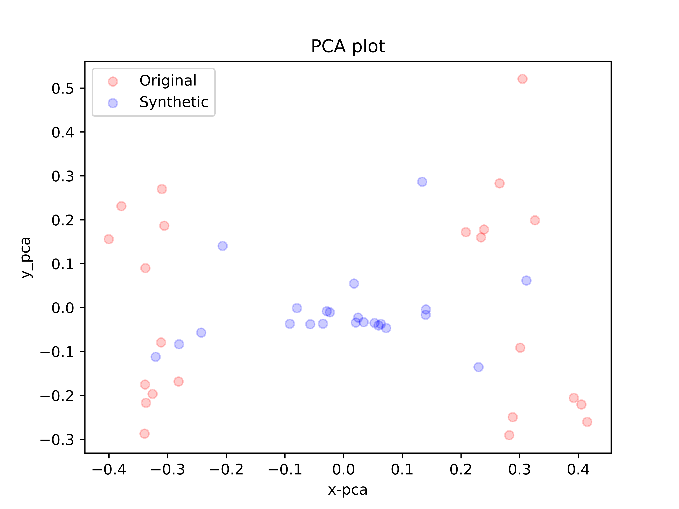
Early Findings and Limitations
TimeGAN - 10.000 Iterations
Notes:
Principal Component Analysis plot, is a way to visualize data in a simplified manner. It takes complex data with many variables (15 in our case) and projects it into a lower-dimensional space.

Slide 12
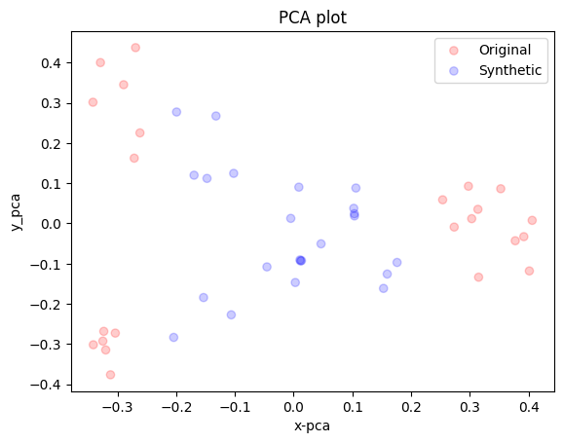
Early Findings and Limitations
RTSGAN - 10.000 Iterations
Notes:
Principal Component Analysis plot, is a way to visualize data in a simplified manner. It takes complex data with many variables (15 in our case) and projects it into a lower-dimensional space.

Slide 13
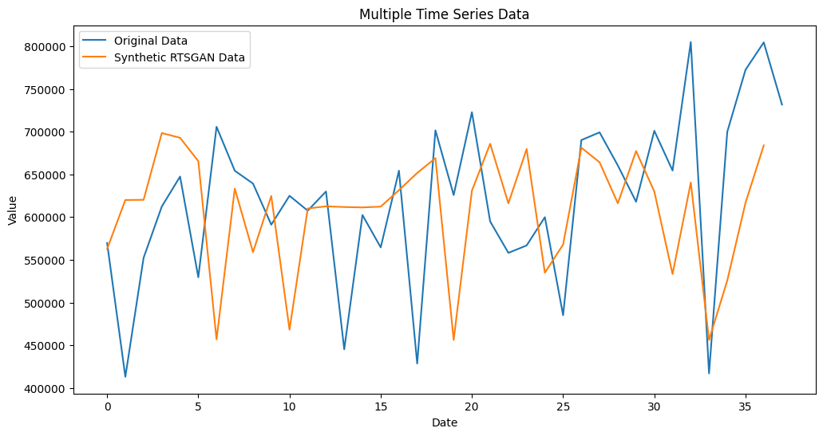
Early Findings and Limitations

